Slide 1


Traumatic Ocular Emergencies
Ine Renata Musa
Ophthalmology Department
Faculty of Medicine Padjadjaran University
National Eye Center Cicendo Eye Hospital
Bandung, July 2018

Slide 2
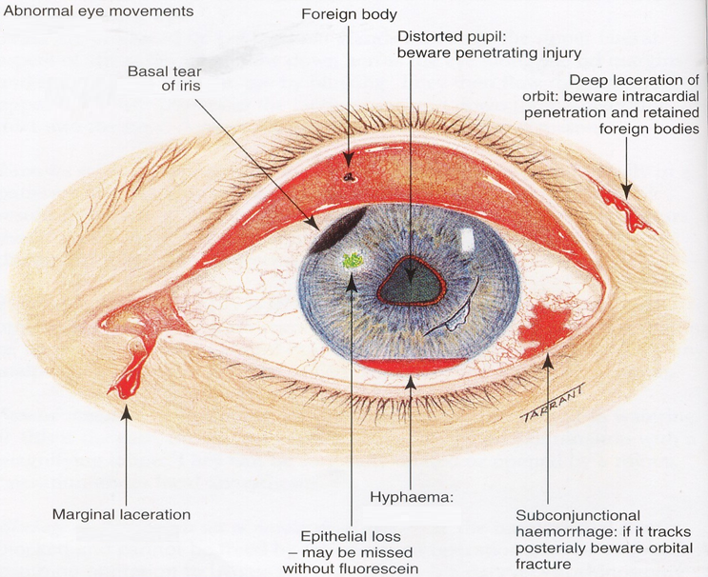
Traumatic Ocular Emergencies

Slide 3
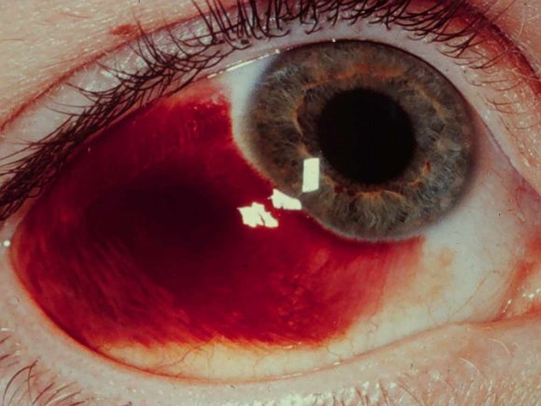
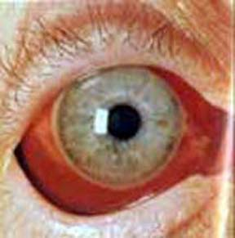
Subconjunctival Hemorrhage
Disruption of conjunctival blood vessel
Etiology:
Trauma
Sneezing
Gagging
Valsalva
Will resolve spontaneously within 2 weeks
If dense, circumferential blood chemosis
→ rule out globe rupture
Notes:
3

Slide 4
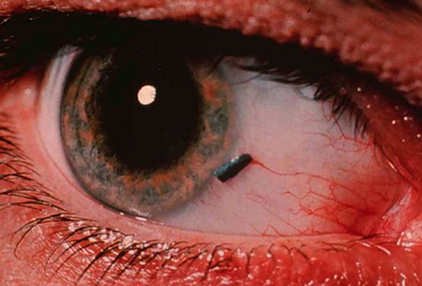
Conjunctival Foreign Bodies
Lid eversion
Remove with a moistened sterile swab
Notes:
4

Slide 5

Lid Eversion Techniques

Slide 6
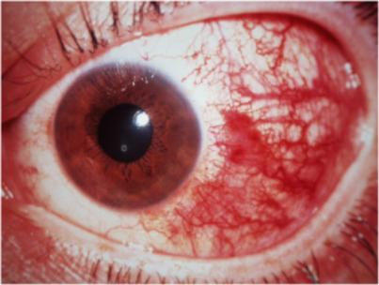
Conjunctival Abrasion
Superficial abrasions
Treatment: 2-3 days of antibiotic ointment
Ocular foreign body should be excluded
Notes:
6

Slide 7
Corneal Abrasion
Symptom:
Tearing, Mild to Severe Red Eye, photophobia, blepharospasm, severe pain
Sign:
Fluorescein: dye uptake at defect site
Rule out foreign body
Treatment:
Topical Antibiotic
Artificial Tears
For supportive treatment consider short-term topical cycloplegic (for comfort/AC activity) and topical NSAID
Contact lens wearers:
Stop wearing Contact Lens
Antibiotic: Fluoroquinolone
Notes:
7
Penyebab corneal abrasion: dry eye, corpus alienum palpebra sup, etc

Slide 8
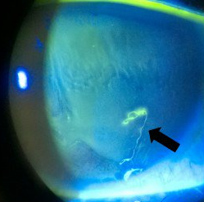
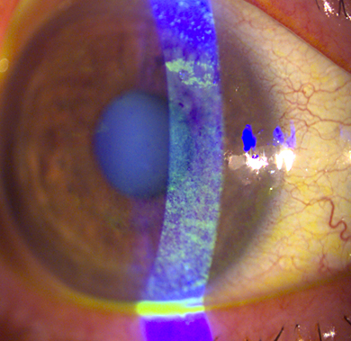
Corneal Abrasion

Slide 9
Corneal Foreign Bodies
Most corneal foreign bodies (FBs) → Metallic.
Microbial keratitis more commonly follows stone, ceramic, and organic FBs.
Remember to exclude a second intraocular or subtarsal FB.
Symptoms:
Photophobia, pain, injection, lacrimation, blurred vision;
history of projectile striking eye;
failure to wear protective eyewear while working, welding, hammering.
Notes:
9
Penyebab corneal abrasion: dry eye, corpus alienum palpebra sup, etc

Slide 10
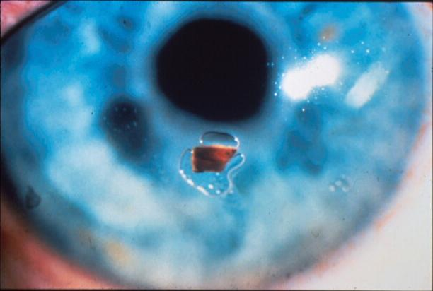
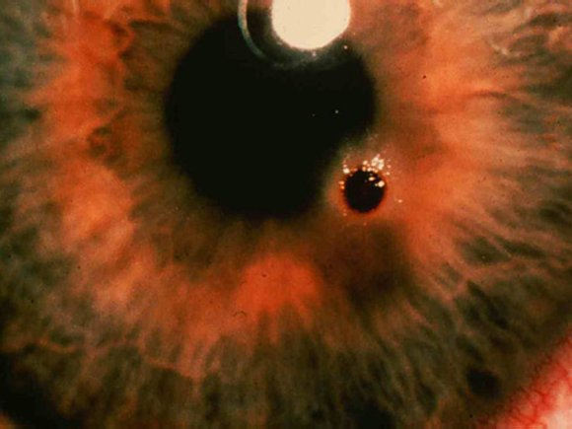
Corneal Foreign Bodies
Signs:
Metallic FB associated rust ring (forms within 48 hours) or infiltrate
± anterior uveitis.
Notes:
10

Slide 11
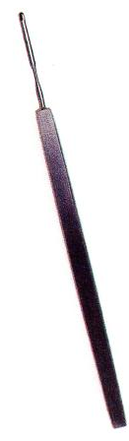
Corneal Foreign Bodies
May be removed with Fine needle tip or eye burr after topical anesthetic applied, under best magnification.
Rust rings can be removed with eye burr, but not urgent.
Follow up in 24 hours for residual rust or deep stromal involvement.
After successfully removed, treat as Corneal Abration.
Notes:
11

Slide 12
Lid Lacerations
History:
Mechanism of injury (and likelihood of associated injuries), likely infective risk (e.g., bites)
Physical exam:
Lid laceration (depth, length, tissue viability), lid position, orbicularis function, lagophthalmos, intercanthal distance
Canalicular involvement, nasolacrimal drainage
Watch for associated injury of globe or orbit
Imaging → Only indicated if associated globe or orbital injury suspected
Notes:
12
Dilatation irrigation of canalicular system: dengan selang silikon sekitar 2 minggu

Slide 13
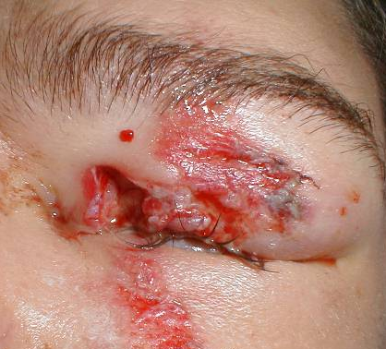
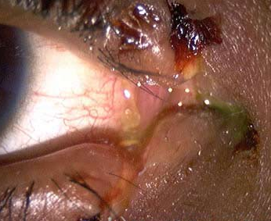
Lid Lacerations
Treatment:
Prophylaxis
Protect cornea with generous lubrication; administer tetanus vaccine if indicated.
Surgery
Assess for surgical repair according to depth, extent of tissue loss, involvement of lid margin, and involvement of canaliculus.
Canalicular involvement → Refer

Slide 14
Blunt Trauma
History
Mechanism, associated injuries, tetanus status
Physical Exam
Immediately assess integrity of globe and visual acuity
Globe: look for anterior or posterior rupture
Cornea: check fluorescein staining, clarity
Iris/ciliary body: note abnormalities of pupil
Lens: opacity, position, stability
IOP
Fundus exam
Imaging
Consider orbital/facial X-ray
CT orbits/brain
Treatment → Refer to higher facility

Slide 15
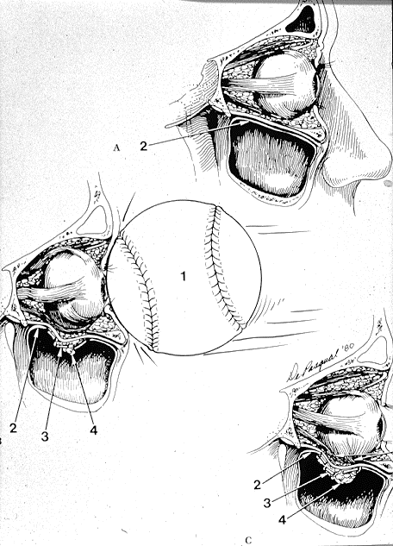
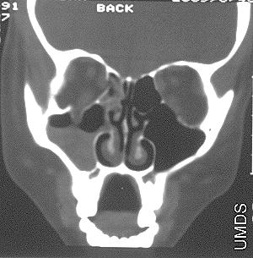
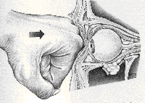
Blowout Fractures
Inferior and medial wall most at risk
Evaluate:
inferior rectus entrapment (diplopia on upward gaze)
infraorbital nerve paresthesia
Enophthalmos
subcutaneous emphysema
Oculocardiac reflex
Imaging → Orbital cut CT scan
Notes:
15
Orbital and medial wall adjacent to sinus air spaces, esp vulnerable to hydrostatic and mechanical forces
V2
Orb cut axial n coronal
Oculocardiac reflex , due to entrapment. Pt nausea bradikardi to asistol

Slide 16
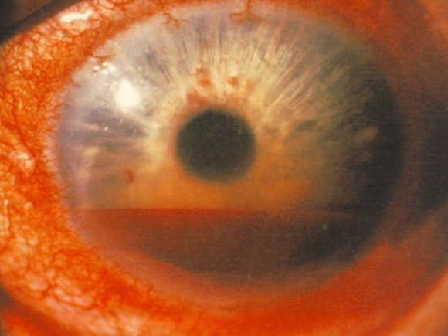
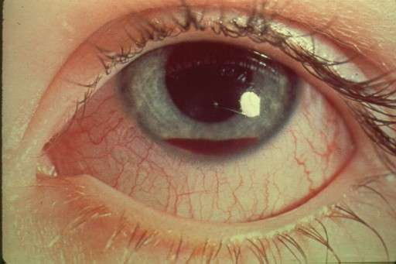
Traumatic Hyphema
Blood in the anterior chamber, disruption of blood vessel in iris or ciliary body.
Treatment:
Bed rest, Head up 30º.
When globe is intact → measure IOP
If IOP > 30 mmHg apply topical timolol
Topical steroid → dexamethasone 0.1% or prednisolone acetate 1% 4x/day
Cycloplegia → atropine 1% 2x/day
Avoid aspirin and antiplatelet agents, NSAIDs, and warfarin if possible
Notes:
16

Slide 17
Penetrating Trauma / IOFBs
Should be excluded following injury from sharp objects and projectiles with high mass and/or velocity.
An intraocular foreign body (IOFB) must be excluded in all cases of penetration.
History
Source (hammer on steel, machinery, explosive), probable IOFB material, likely toxicity and infective risk, tetanus status.
Physical Exam
Entry site: identify location and integrity (leak) of wound → Seidel Test
Low or asymmetric IOP
Location

Slide 18
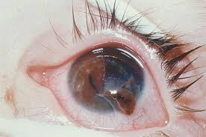
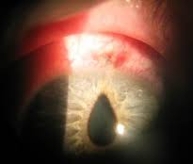
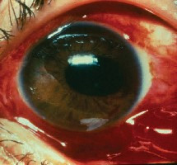
Penetrating Trauma / IOFBs
Physical Exam findings
Severe subconjunctival hemorrhage
Shallow or flat anterior chamber
Hyphema
Iris deformities
Tear-drop shaped pupil
Limited extraocular motility
Extrusion of globe contents
Significant reduction in visual acuity

Slide 19
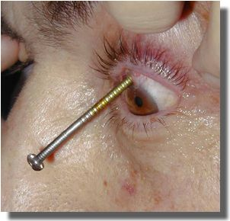
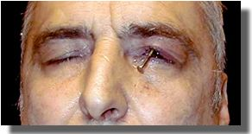
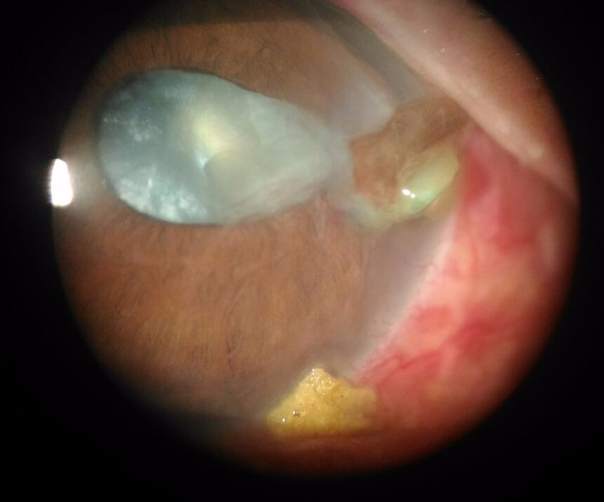
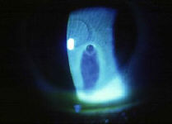
Penetrating Trauma / IOFBs
Seidel’s Test
Fluorescein
streaming

Slide 20
Penetrating Trauma / IOFBs
If a globe injury is suspected:
Don’t manipulate the eye any more
Orbital X-ray or Orbital CT → foreign body?
Place the patient upright
Protective eye shield
Cycloplegic
Administer IV antibiotic and antiemetic
Tetanus prophylaxis
REFER !

Slide 21
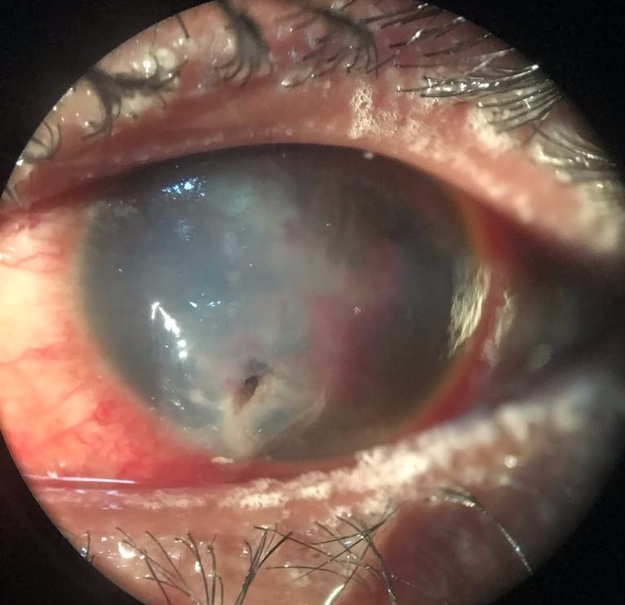
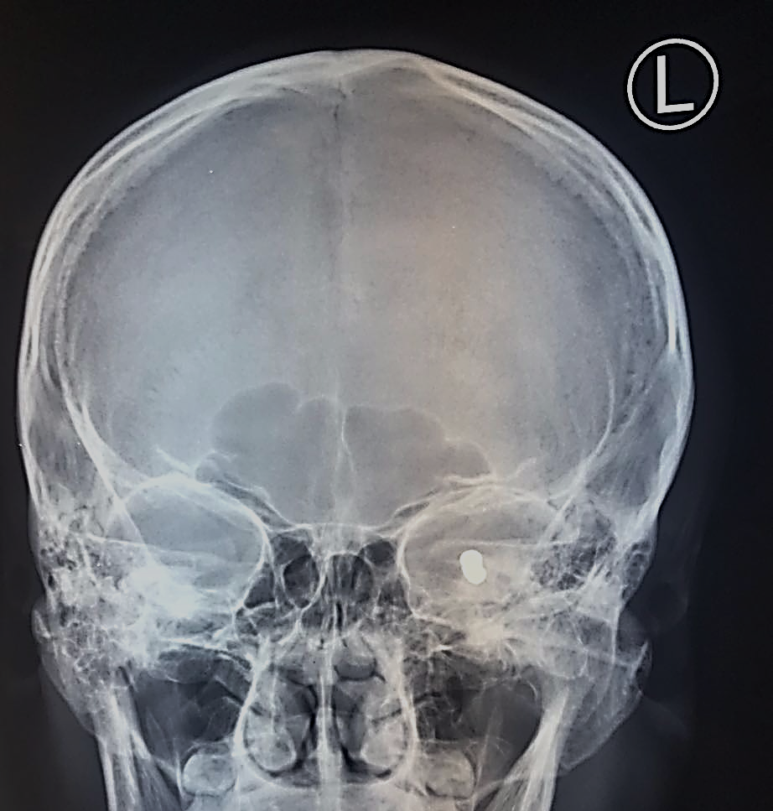
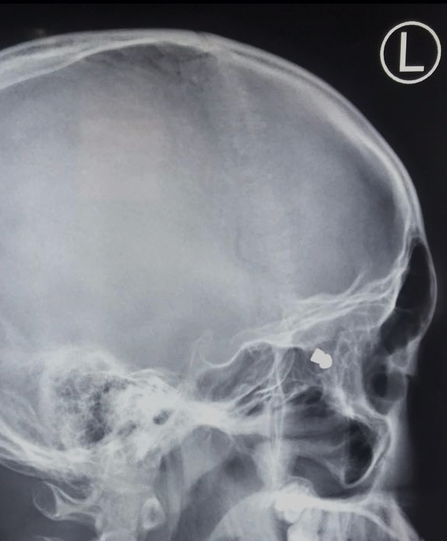
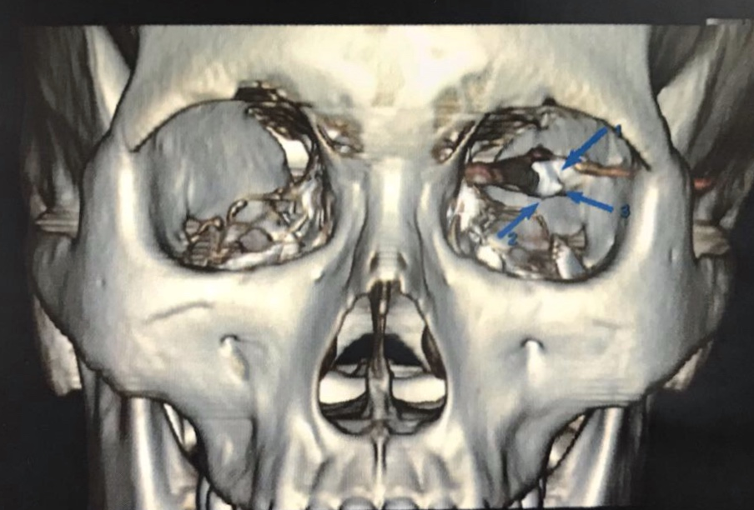
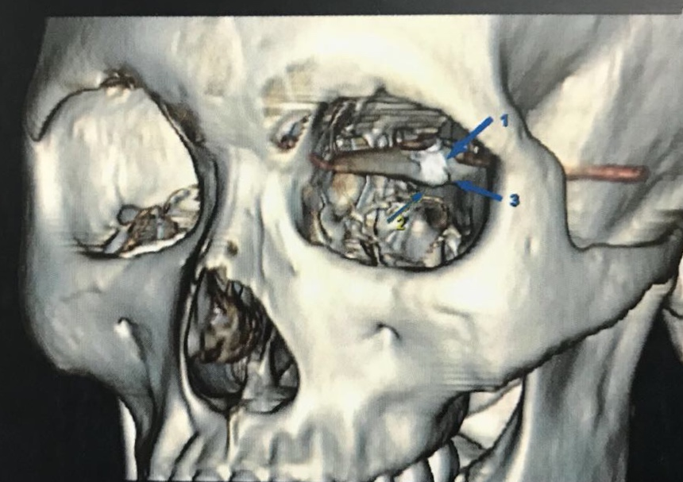
Penetrating Trauma / IOFBs

Slide 22
Chemical Ocular Injury
Acid or alkali
Alkali → saponification
Before a full history or detailed examination is conducted, give copious irrigation immediately until neutral or near-neutral pH (neutral pH=7.0) → by pH/ litmus paper.
Evert the lids to remove retained particulate matter in fornices.
Recheck pH after sweeping the fornices for retained particles.
Measure IOP

Slide 23
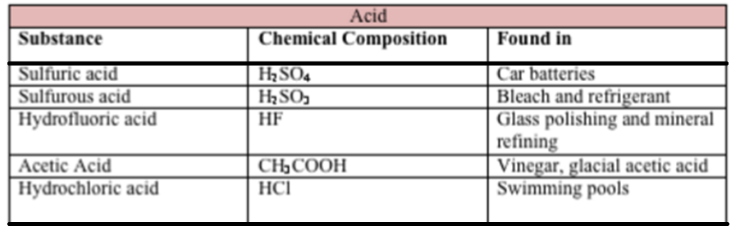
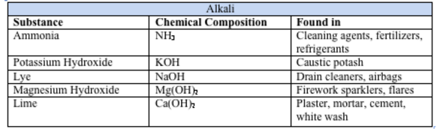
Chemical Ocular Injury

Slide 24
Chemical Ocular Injury
Acute—all injuries
Admit if injury is severe or there are any other concerns.
Topical antibiotics: prophylaxis.
Topical cycloplegia for comfort/AC activity (e.g., preservative-free cyclopentolate 1% 3x/day).
Topical lubricants.
Oral analgesia.
Topical medication should be preservative-free when possible!

Slide 25
Chemical Ocular Injury
Acute — severe injuries
Topical steroids (e.g., prednisolone acetate 0.5–1% initially 4–8x/day for <10 days),
Topical ascorbic acid (e.g., sodium ascorbate 10% up to every 2 hours for <10 days), and
Oral ascorbic acid (e.g., 2 g 4x/day) → collagen formation.
Acute — injuries with High IOP
Give acetazolamide 250 mg 4x/day ± topical B-blocker (e.g., preservative-free timolol 0.5% 2x/day)
REFER !

Slide 26
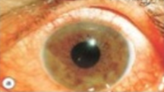
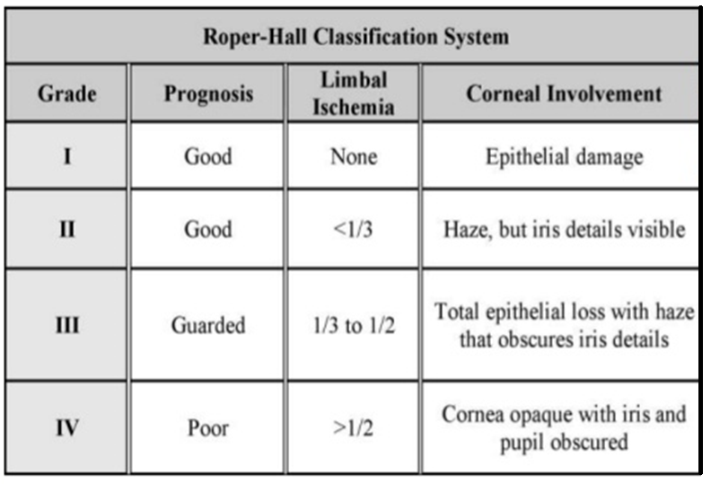
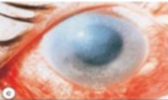
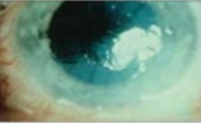
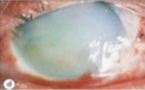
Chemical Ocular Injury

Slide 27
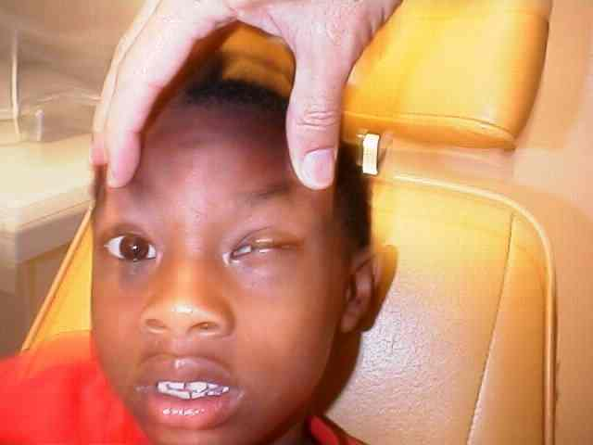
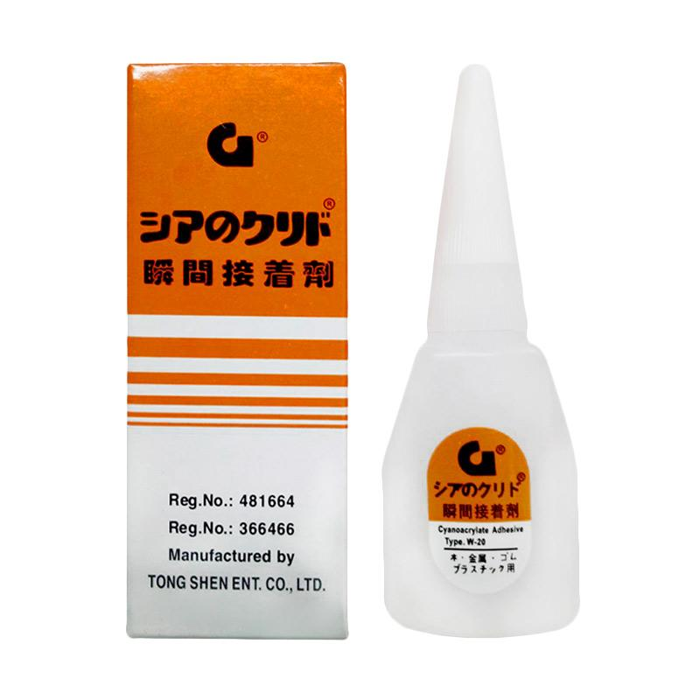

Chemical Ocular Injury
Cyanoacrylate Glue
Antibiotic ointment.
Remove pieces that are easy to remove.
Remove residual glue max. within 48 hours.
Notes:
27
Glue
Injury occurs only as a result of hard particles that form after drying
Treatment:

Slide 28
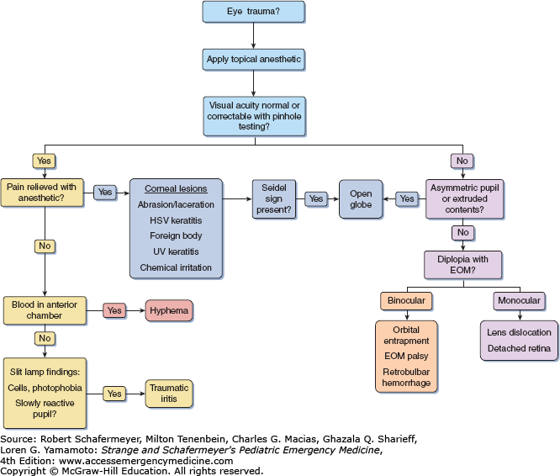
SUMMARY

Slide 29
Take Home Messages
We need immediate response to manage traumatic ocular emergency cases.
To exclude some differential diagnosis in traumatic ocular emergency cases, orbital imaging are needed.
Good history taking and physical examination, especially ophthalmology examination, is very useful to choose the next action.

Slide 30


