Slide 1
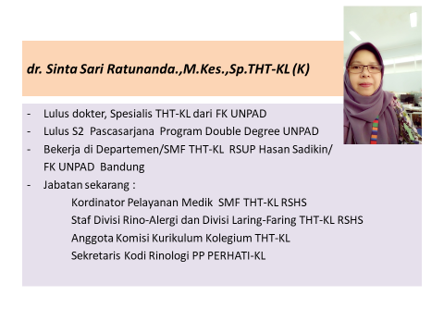

Slide 2


TATALAKSANA RINOSINUSITIS DI LAYANAN PRIMER
Dr. Sinta Sari Ratunanda, M.Kes, SpTHT-KL(K)
Bandung - 2018

Slide 3
TUJUAN
Latar Belakang
Definisi dan Klasifikasi Rinosinusitis
Diagnosis Rinosinusitis
Tatalaksana Rinosinusitis
Tatalaksana Rinosinusitis Akut
Tatalaksana Rinosinusitis Kronis
Peranan Nasal Dekongestan

Slide 4
LATAR BELAKANG

Slide 5
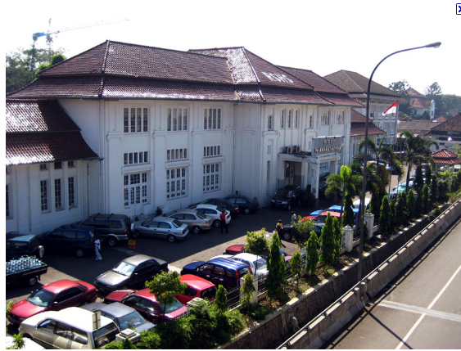
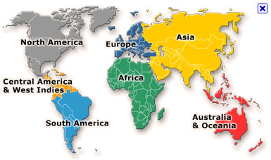
Epidemiologi >>
RSHS, 2008 : 75 % Rhinosinusitis
USA 2005 :
135 : 1000 populasi
Europe 2005 :
10%-30% adult
40% children
James A.Hadley,Mani S.Kavuru,Jack B.Anon,Lily C.Pien,Diagnosis and Management Rhinitis and Rhinosinusitiis,Third edition,2005

Slide 6
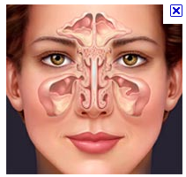
DEFINISI
RINOSINUSITIS:
Inflamasi mukosa sinonasal yang ditandai oleh ≥ 2 gejala :
Salah satunya harus : Hidung tersumbat atau hidung beringus
Nyeri pada wajah/kepala
Gangguan penciuman / BATUK

Slide 7
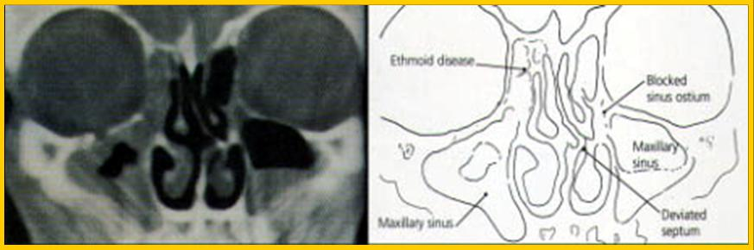
Definisi…
disertai gambaran Nasoendoskopi :
Sekret dari ostium sinus, atau
Kongesti hidung, atau
Polip
dan/atau : Penebalan mukosa pada CT Scan

Slide 8
Klasifikasi
RINOSINUSITIS
KRONIK > 12 MINGGU
DISERTAI POLIP
TANPA POLIP
AKUT < 12 MINGGU

Slide 9
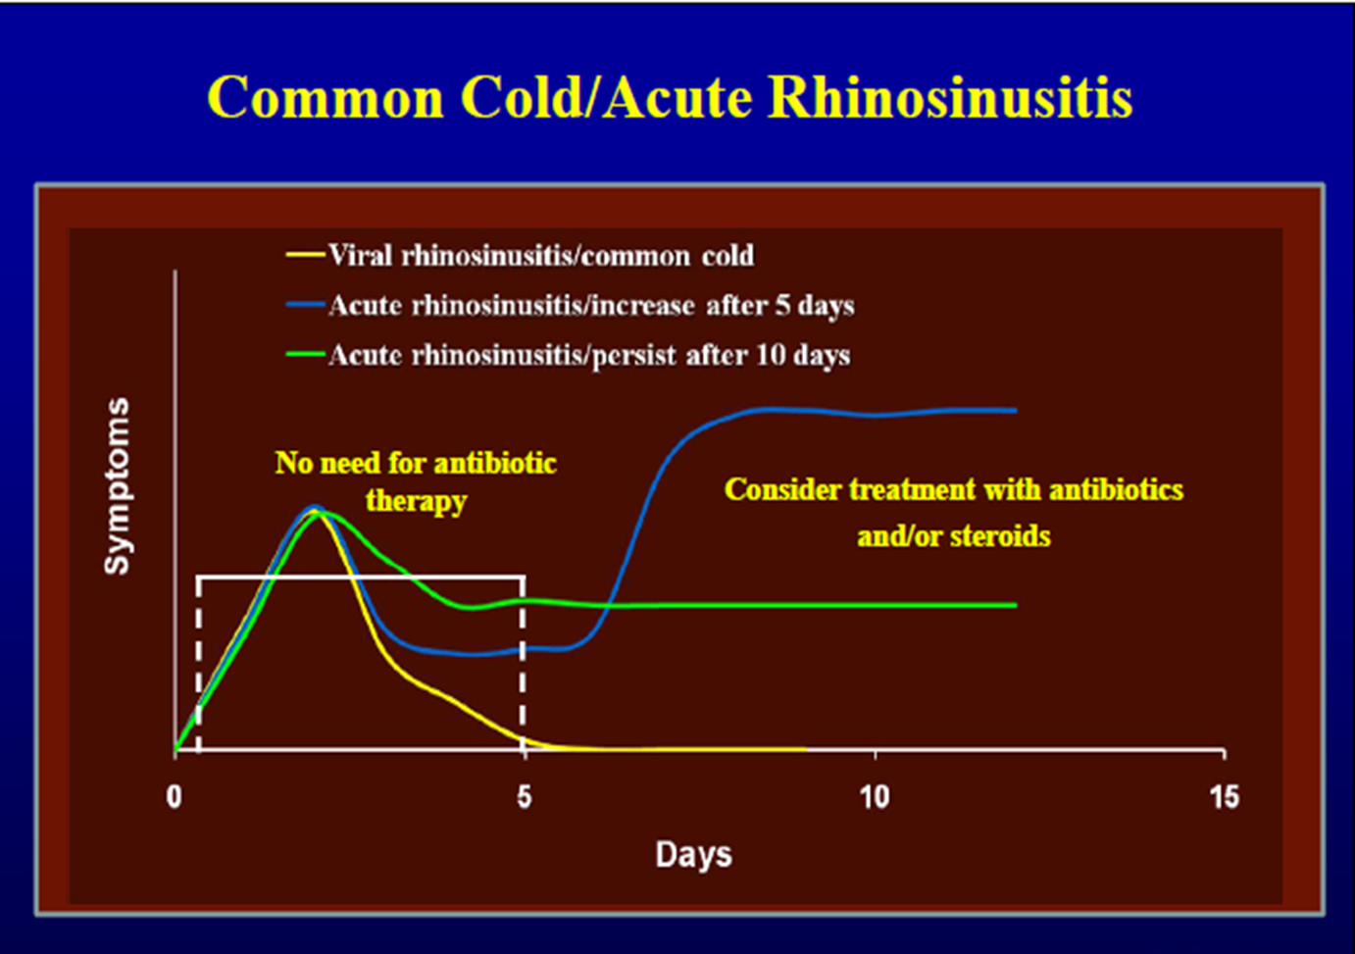

Slide 10
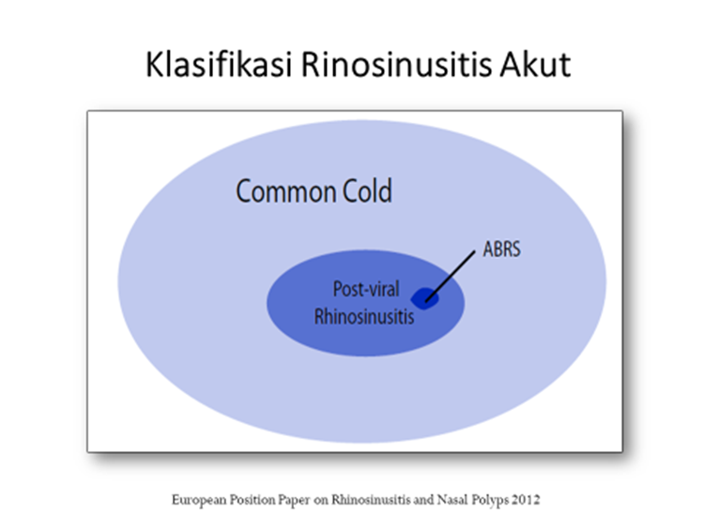

Slide 11
DIAGNOSIS..
ANAMNESIS
PEMERIKSAAN FISIK
PEMERIKSAAN PENUNJANG

Slide 12
ANAMNESIS……..
HIDUNG TERSUMBAT
MELER/PILEK
NYERI WAJAH/SEKITARNYA
GANGGUAN PENCIUMAN/
BATUK

Slide 13
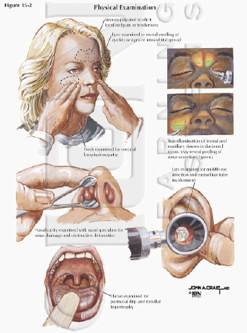

Slide 14
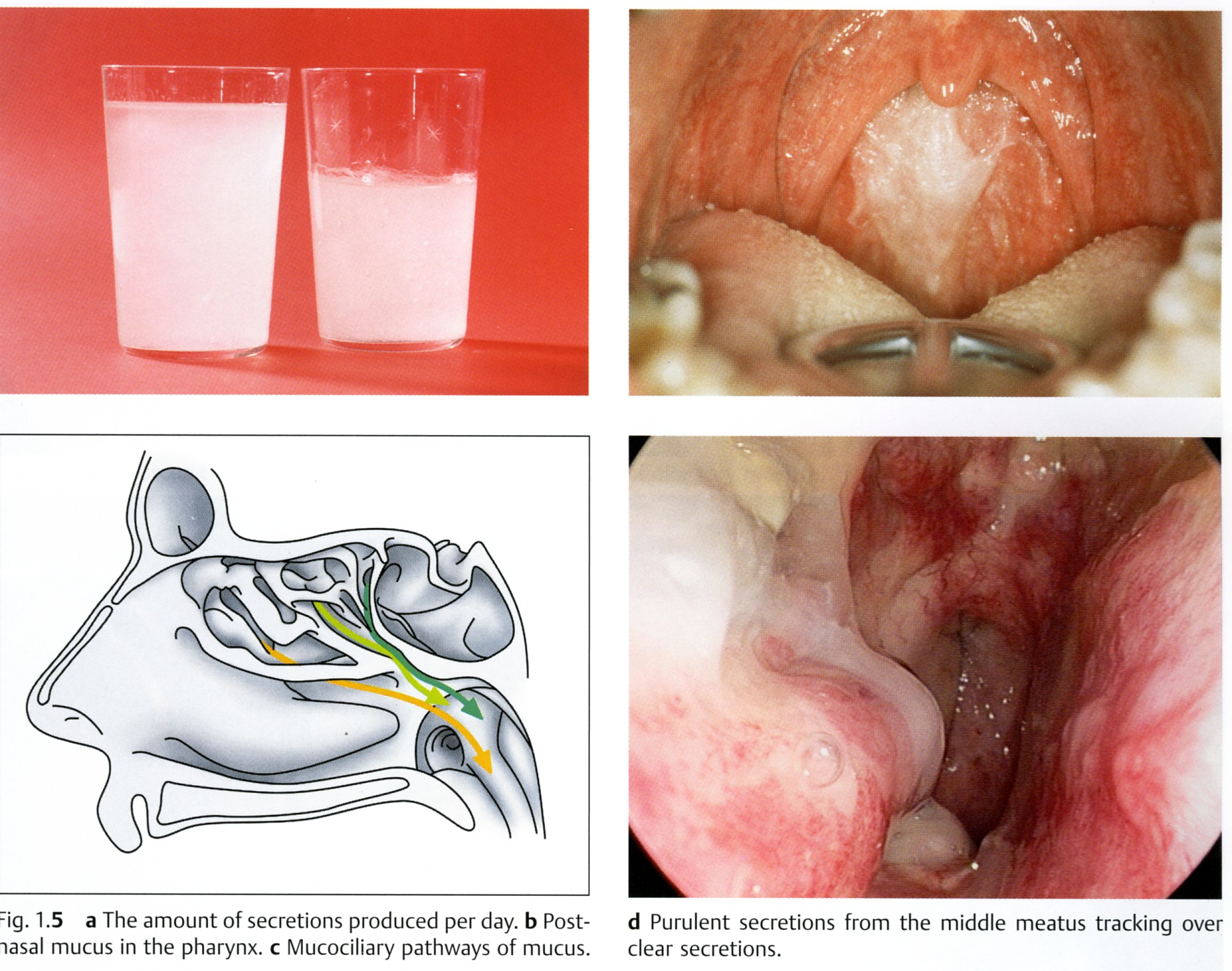

Slide 15
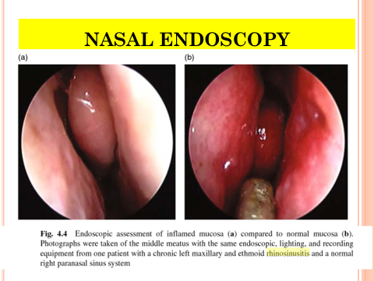

Slide 16
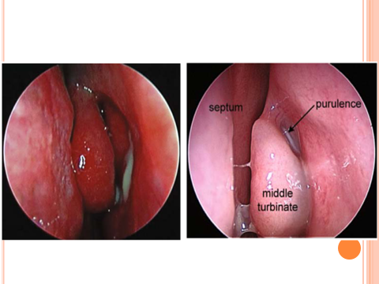

Slide 17
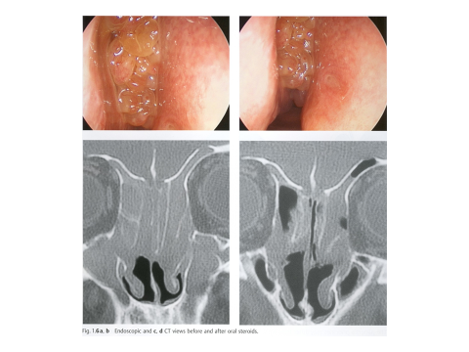

Slide 18
TATALAKSANA RINOSINUSITIS

Slide 19
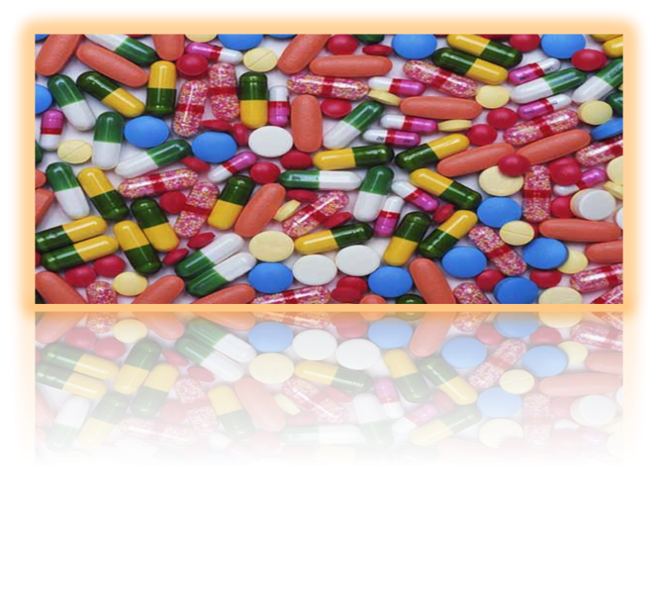
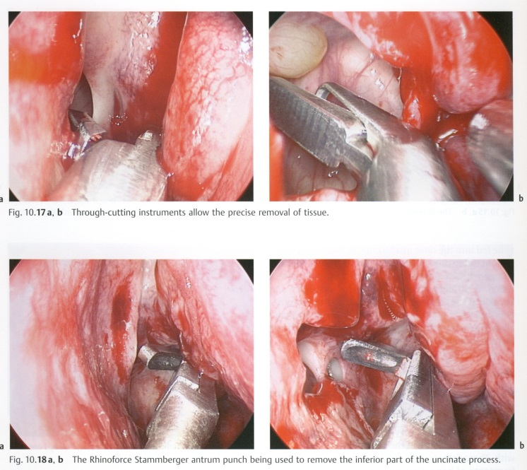
Tatalaksana Rinosinusitis
MEDIKAMENTOSA
TINDAKAN/OPERATIF
apabila medikamentosa
gagal/komplikasi:
BEDAH SINUS ENDOSKOPIK

Slide 20
MEDIKAMENTOSA
Pemberian medikamentosa pada Rinosinusitis meliputi :
Nasal irigasi/cuci hidung menggunakan larutan NaCl fisiologis (setara)
Pemberian antibiotika sesuai indikasi
Kortikosteroid intranasal
Terapi suportif /simptomatik
Terapi untuk faktor predisposisi Rinosinusitis (pada rinosinusitis kronik terutama).

Slide 21
Tatalaksana RINOSINUSITIS AKUT
CUCI HIDUNG
NASAL KORTIKOSTEROID
SIMPTOMATIK
ANTIBIOTIK

Slide 22
TATALAKSANA RINOSINUSITIS AKUT

Slide 23
VIRAL RHINOSINUSITIS…. Tatalaksana: Suportif - Simptomatik
Rinosinusitis akut viral (Acute Viral Rhinosinusitis/common cold) ditandai dengan tanda dan gejala dari rinosinusitis akut, yang disebabkan oleh infeksi virus , dengan gejala dan tanda dapat berlangsung kurang dari 5 hari – 10 hari dan gejala membaik.
Apabila gejala menetap lebih dari 10 hari (tetapi tidak ada perburukan gejala), hal ini disebut Postviral Acute Rhinosinusitis

Slide 24
Tatalaksana Rinosinusitis Akut Viral
Terapi tambahan/ suportif:
Dekongestan
anti histamin
analgetik & antipiretik
Kortikosteroid topikal
cuci hidung larutan garam fisiologis
mukolitik
herbal

Slide 25
Pemberian Antibiotik: Rinosinusitis Akut Bakterialis
Rinosinusitis akut disebut Rinosinusitis Akut Bakterialis bila memenuhi 3 dari 5 kriteria di bawah ini :
1. Hidung beringus berwarna/sekret hidung mukopurulen(terutama unilateral)
2. Nyeri berat di wajah/pipi/dahi(terutama unilateral)
3. Demam (lebih dari 38º)
4. Meningkatnya Laju Endap Darah atau CRP (C-Reactive Protein)
5. Double sickening (gejalanya menjadi berat kembali setelah ada sempat perbaikan awal)

Slide 26
Pemberian antibiotik: Rinosinusitis Akut Bakterialis
Antibiotik Lini I (amoksisilin + klavulanat)/eritromisin) observasi selama 3 – 5 hari.
Bila perbaikan kurang, berikan :
Antibiotik Lini II golongan : sefalosporin, kuinolon, makrolid

Slide 27
Tatalaksana Rinosinusitis Akut Bakterialis
Terapi suportif :
cuci hidung larutan garam fisiologis
anti histamin,
analgetik & antipiretik
kortikosteroid topikal
dekongestan
mukolitik
herbal

Slide 28
Bailey Byron J.and Jonas T. Johnson. Head and Neck Surgery – Otolaryngology, 5th edition. Volume 1. Philadelphia: Lippincot, William and Wilkins, 2014.

Slide 29
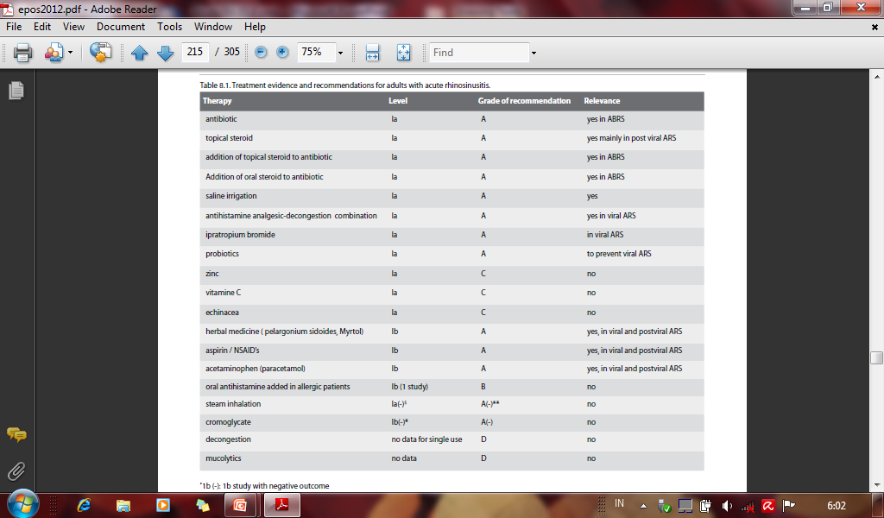

Slide 30
Tatalaksana RINOSINUSITIS KRONIS
Kortikosteroid merupakan terapi medikamentosa lini pertama pada rinosinusitis kronis (Kortikosteroid topikal/Kortikosteroid sistemik)
Antibiotik???? (ya pada eksaserbasi akut)
Cuci hidung larutan garam fisiologis
Antihistamin: Diberikan hanya pada pasien dengan rinitis alergi
Terapi suportif dan terapi predisposisi Rinosinusitis kronik

Slide 31

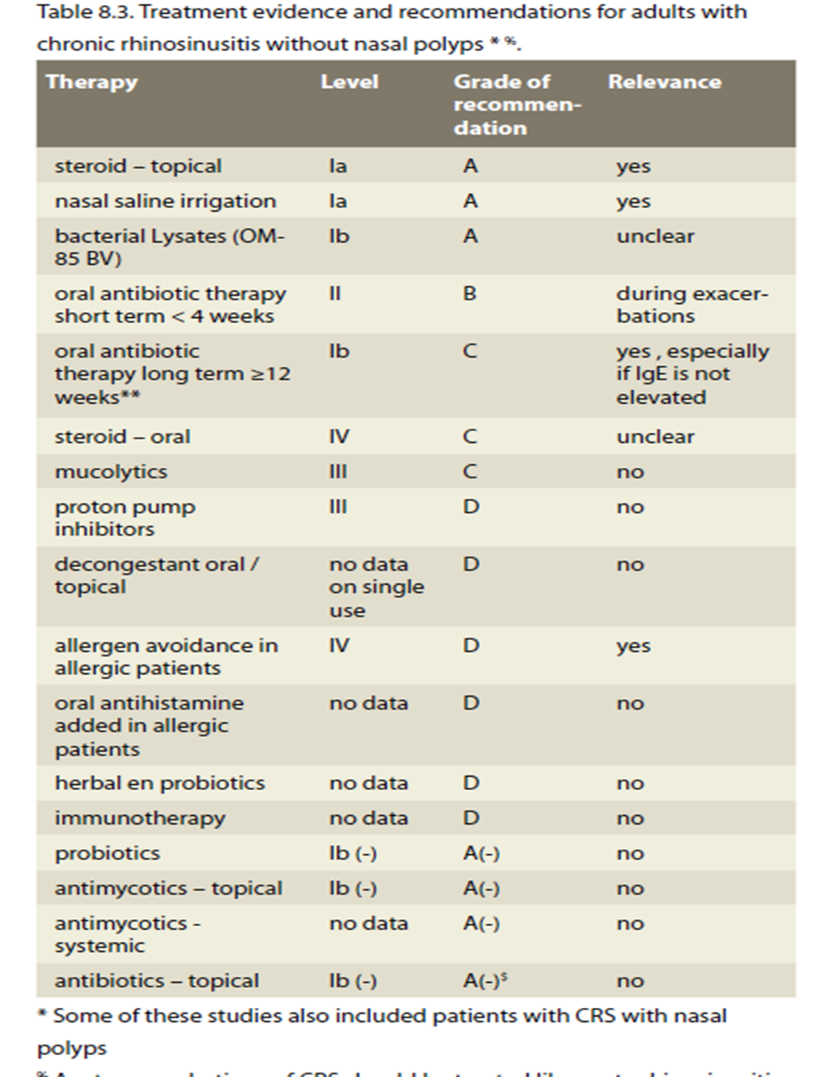

sana Rinosinusitis Kronis

Slide 32

SURVEY
Passali D, Cingi C, Cambi J, Passali F, Muluk N, Bellussi M. A survey on chronic rhinosinusitis: opinions from experts of 50 countries. European Archives Of Oto-Rhino-Laryngology [serial on the Internet]. (2016, Aug)
CRS patients were principally treated by otorhinolaryngologists (70 %).
Medical treatments included nasal corticosteroids (90 %), nasal washes (68 %), and nasal decongestants (32 %).
In 88 % of countries, more than 50 %, or 'about 50 %', of all patients reported subjective symptom improvement after treatment.

Slide 33
Peranan Oksimetazolin dalam Tata Laksana Kongesti Hidung

Slide 34
Classification of Nasal Decongestants
selective α1 agonist
Phenylephrine
Selective α2 agonist
Naphazoline
Xylometazoline
Oxymetazoline
α-Adrenergic Agonist
Pseudoephedrine
Phenylpropanolamine
Oxymetazoline

Slide 35
Overview of Nasal Decongestants
 | Naphazoline | Xylometazoline | Oxymetazoline | Pseudoephedrine | Phenylpropanolamine
Mode of action | Selective α2 agonist) | Selective α2 agonist) | Selective α2 agonist) | Alpha-Adrenergic Agonist. | Directly stimulate adrenergic receptors but probably indirectly stimulates both α- and β-adrenergic receptors
Duration of action | Longer duration of action (12 hours) | Longer duration of action (10 hours)² | Long duration of action (12 hours)
Dose | 0.1% topical in nose | 0.05–0.1% topical in nose | 0.025–0.05% topical in nose | 30- 60 mg three times a day | 25–50 mg daily
Adverse effects | Impairs mucosal ciliary function causing Atrophic rhinitis and anosmia, CNS depression and rise in BP, initial stinging sensation | Impairs mucosal ciliary function causing Atrophic rhinitis and anosmia, CNS depression and rise in BP | Impairs mucosal ciliary function causing Atrophic rhinitis and anosmia, CNS depression and rise in BP | Rise in BP can occur, especially in hypertensive, CNS effects | Rise in BP

Slide 36
Oxymetazoline-Structure and Mechanism of action
Imidazole derivative with direct acting sympathomimetic activity¹
Chemical Name - 6-tert-butyl-3-(4,5-dihydro-1H-imidazol-2-ylmethyl)-2,4-dimethylphenol
Molecular Formula - C₁₆H₂₄N_{2O}
Molecular weight - 260.37456 g/mol
Mechanism of Action ²
Oxymetazoline is a direct acting sympathomimetic amine
In nasal it produces constriction, resulting in decreased blood flow and decreased nasal congestion
Acts on alpha-adrenergic receptors in the arterioles of the conjunctiva and nasal mucosa

Slide 37
Summary of Triple Action of Oxymetazolin
 | Pharmacodynamic Properties of Oxymetazoline |  | Scientific Evidence | Clinical benefit | Effect on Course of disease
Antiviral | Inhibitis the activity of HRV 14, downregulates virus receptor ICAM-1 | Causal Effect | In vitro Studies ^{1,2} | Fights the viruses that cause rhinitis | faster and stronger improvement of symptoms like sneezing, rhinorrhea, nasal obstruction, impaired taste and smell and general well-being + Shortens the duration of cold from 6 to 4 days
Antioxidative/ Anti-inflammatory | Inhibits pro-inflammatory pathways, suppresses oxidative stress | Pathogenetic Effect | In vitro Study ³ | Inhibits rhinitis symptoms
Vasoconstrictive | de-swelling of nasal mucosa | Symptomatic Effect | Clinical Study ⁴ | Decongestion of the nose, easy breathing and outflow of secretion and germs
Clinical Study ⁵
(vs. Saline solution)
Notes:
Sacher et al., 2005 Antiviral Properties of Oxymetazolin, DAZ, No. 5: 111-112
Glatthaar-Saalmueller B et al. 2005. Oxymetazoline exerts antiviral activity against human rhinovirus-14 and downregulates expression of ist receptor ICAM-1 on human umbilical vein endothelial cells. OEGAI Annual Meeting, Graz/Austria, December 01-03: P51.
3) Beck-Speier et al., 2006, Oxymetazoline Inhibits Proinflammatory Reactions: Effects on Arachidonic Acid-Derived Metabolites, JPET 316: 843-851. Westerveld et al,1995, Anti-oxidant actions of oxymethazoline an xylomethazoline, Eur J Clin Pharmacol 291: 27-31
Connell JT., 1969, Effectiveness of topical nasal decongestants. Annals of Allergy 27: 541-546
Reinecke S. & Tschaikin M., 2005, Investigation of the effect of oxymetazoline on the duration of rhinitis.
Results of a placebo-controlled double-blind study in patients with acute rhinitis. MMW Fortschr Med 147 Suppl 3:113-118

Slide 38
Indikasi Oksimetazolin
Rinitis Alergi
Rinitis Non Alergi
Rinosinusitis Akut dan Kronis
Rinosinusitis Kronik disertai Polip

Slide 39
Pemberian Oksimetazolin
Pemakaian Kombinasi dengan Preparat lain
Lama pemakaian : 3 – 5 hari
Cara Pemakaian yang benar
Dosis anak dan dewasa diperhatikan
Edukasi kepada pasien

Slide 40
Take Home Message
Pentingnya mengenal pengertian dan klasifikasi Rinosinusitis → membuat tatalaksana yang sesuai
Mengenal tatalaksana yang bisa dilaksanakan di layanan primer
Mengenal peranan dekongestan dalam tatalaksana Rinosinusitis

Slide 41

Hatur Nuhun

