Slide 1







Diagnosis & Management of
Musculoskeletal Trauma
Widya Arsa, dr., Sp.OT, CCD.
Orthopaedics and Traumatology Department
Hasan Sadikin General Hospital - Universitas Padjadjaran
Bandung

Slide 2
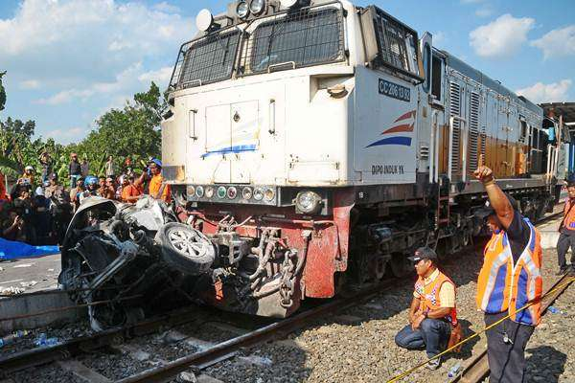
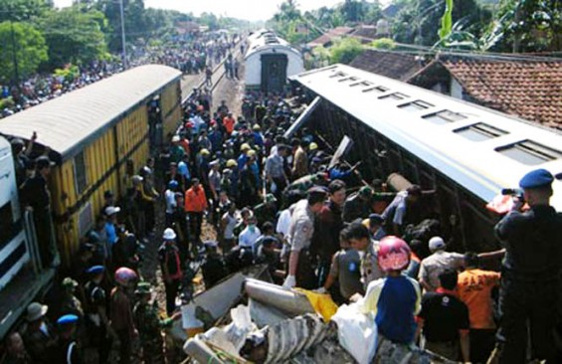
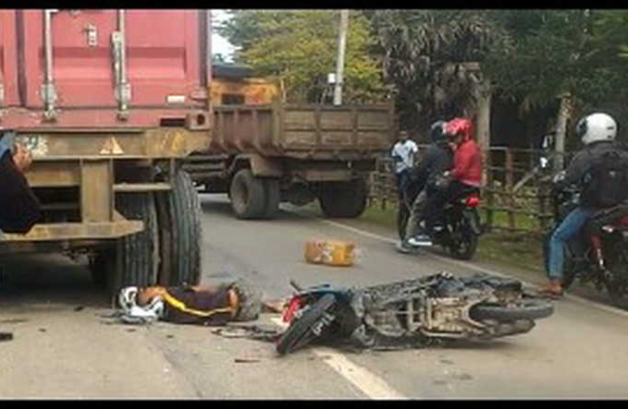
INTRODUCTION
Skeletal trauma : 85 % of blunt trauma
In Indonesia: 57.726 cases of accidents (POLRI, 2009)
Resuscitation STILL becomes the priority
Accident Scene
In Indonesia ....

Slide 3

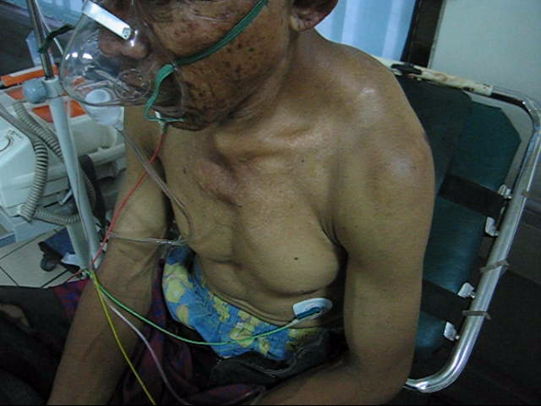
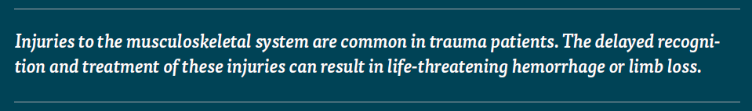
Life before Limb !!

Slide 4
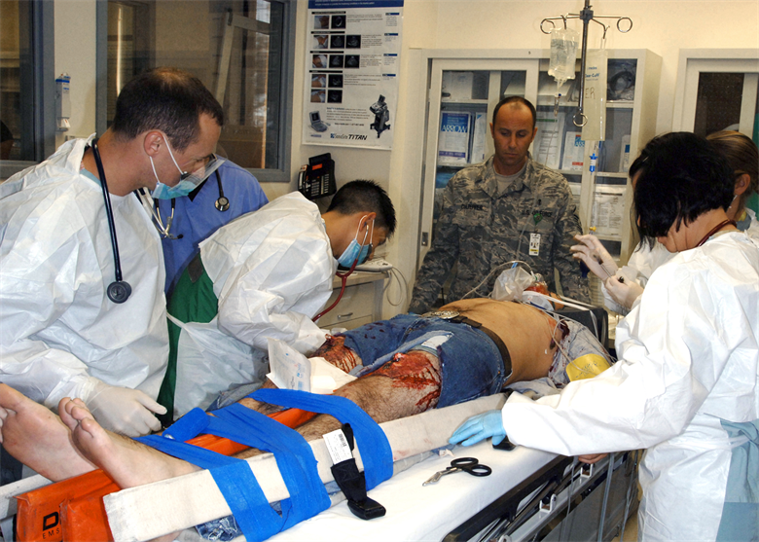
PRIMARY SURVEY RESUCITATION
  A irway (+cervical spine control)
  B reathing
  C irculation (+ control of hemorrage)
  D isability (neurological condition)
  E xposure (take the patient clothes off)

Slide 5
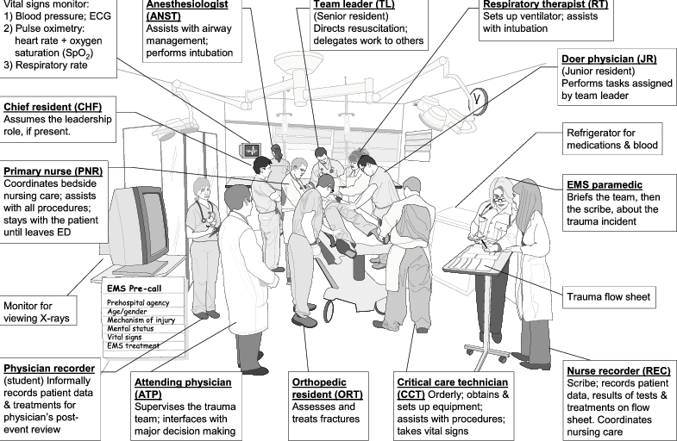

Slide 6
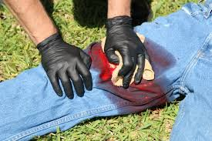
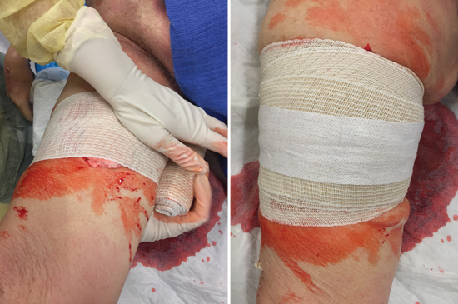
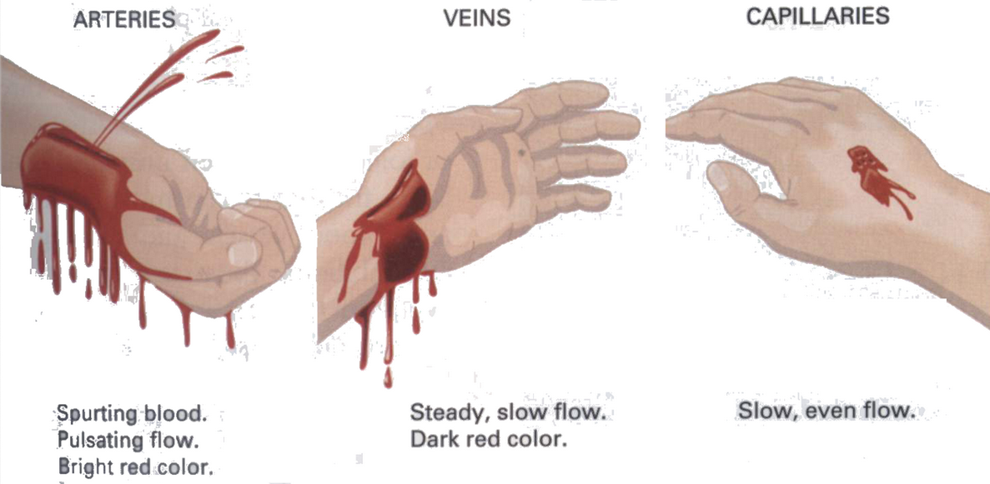
Bleeding Control
DIRECT PRESSURE
SPLINTING
FLUID RESUCITATION

Slide 7
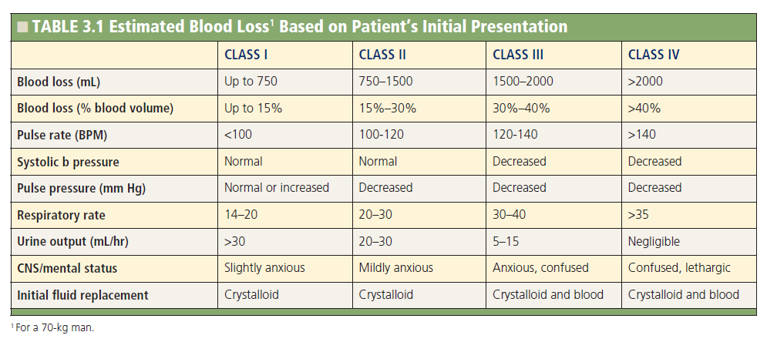
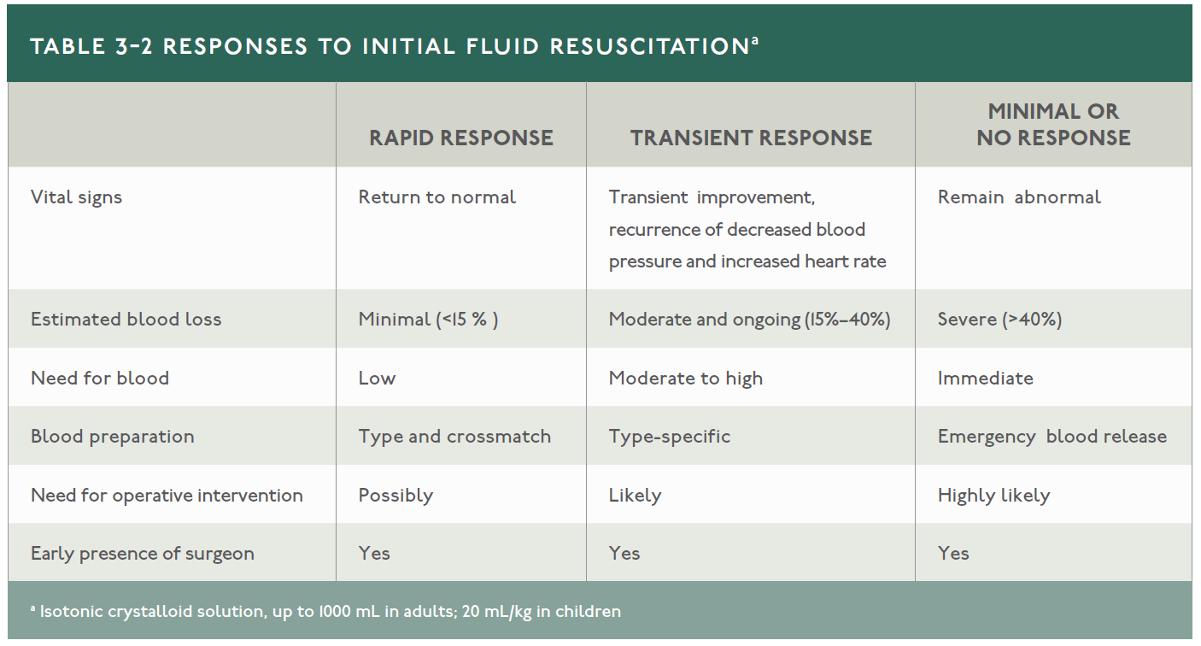

Slide 8
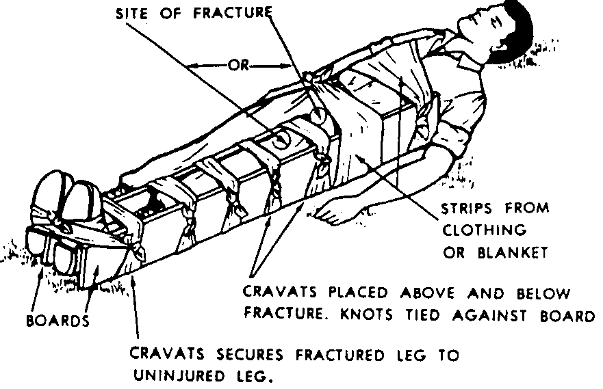
PRIMARY SURVEY RESUCITATION
Adjuncts : Fracture immobilization
Method :
  Traction→ anatomical position
  Splint
  Check for dislocation !
Apply splint early, but avoid delay in resuscitation
Goals
  Hemorrhage control
  Pain relief
  Prevent further
  soft-tissue injury

Slide 9
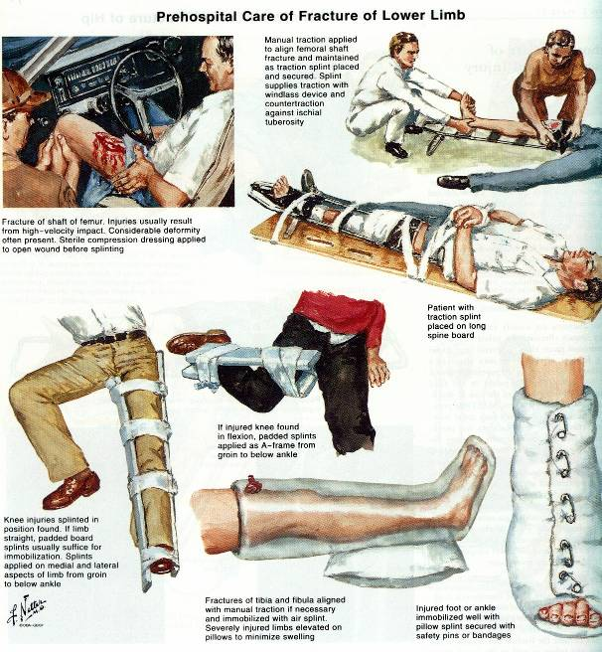

Slide 10
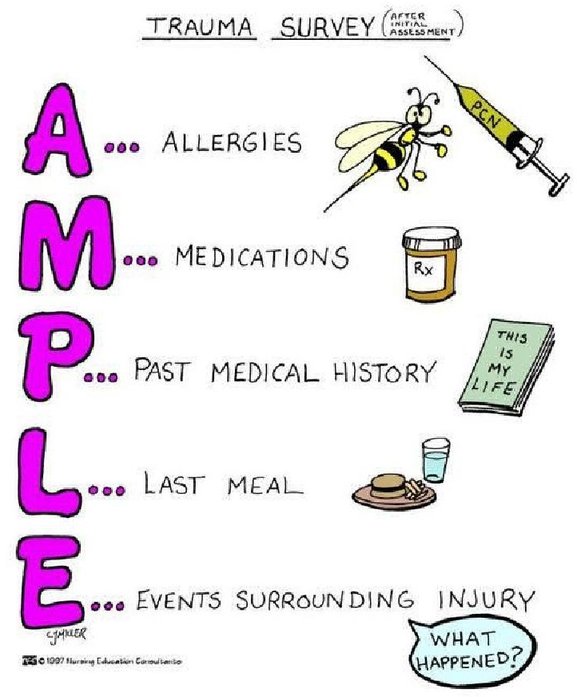
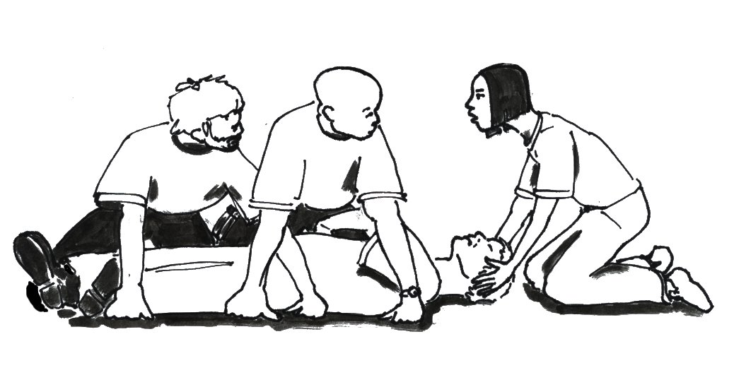
SECONDARY SURVEY
History ( A M P L E )
From head to toe examination
Every orifice must be examined
Don’t forget the back!

Slide 11
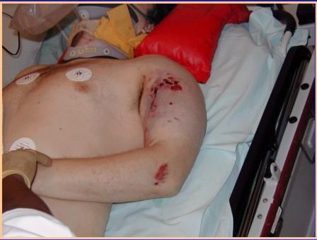
SECONDARY SURVEY
LOOK
Deformity
Swelling
Bruising
Wound(s)
FEEL
Tenderness
Neurologic Deficits
Pulses
MOVE
Active/Passive ROM
Crepitus
Abnormal movements

Slide 12
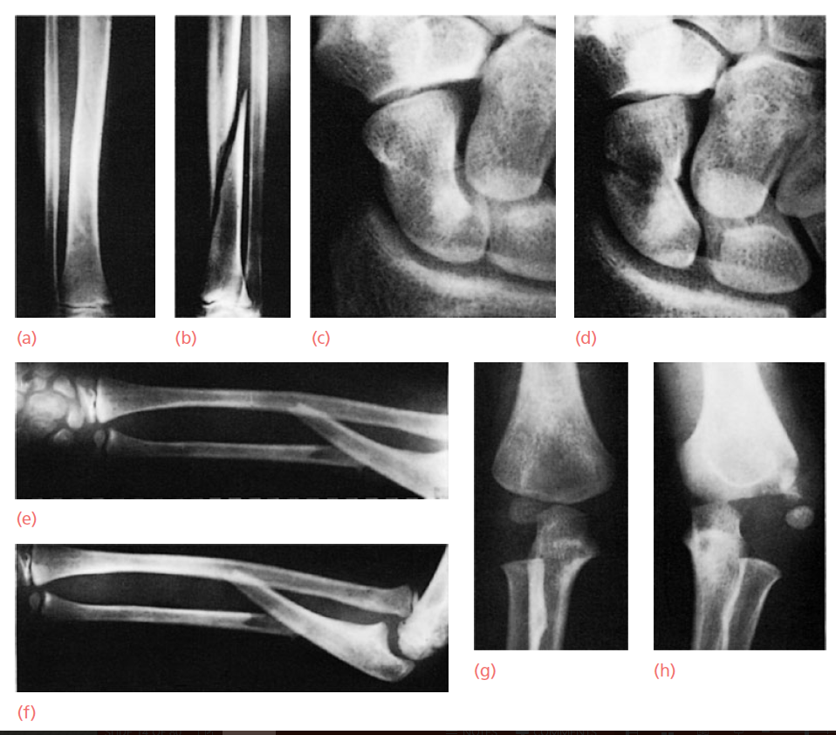
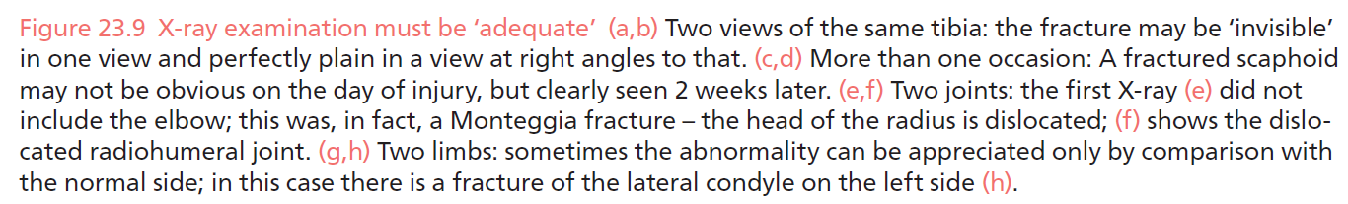
SECONDARY SURVEY
X-ray in Secondary Survey
Guided by clinical findings
  Two Views
  Two Limbs
  Two Joints
  Two Injuries

Slide 13
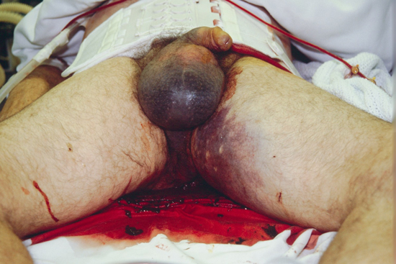

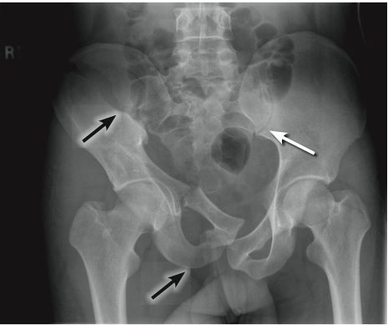
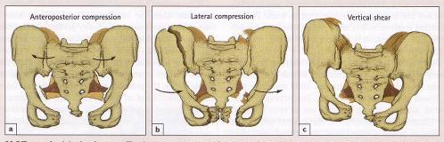
Life Threatening
Musculoskeletal Trauma
1) Pelvic Trauma
with Massive Bleeding
Hemorrhage occurs rapidly
Unexplained hypotension
Open wounds, meatal bleeding, high prostate,
Expanding hematoma (pelvic, scrotal, perianal)
Palpable motion of pelvic ring

Slide 14
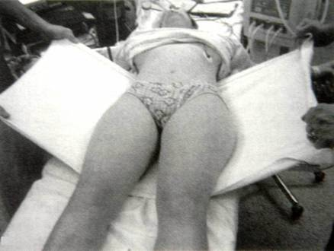
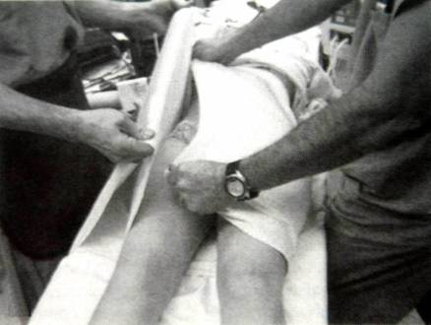
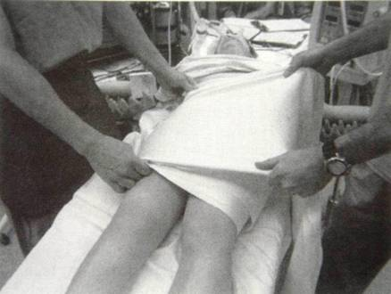
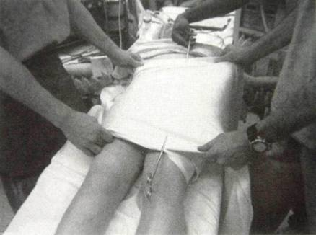
Pelvic Wrapping
DISADVANTAGES
Non anatomical
Soft tissue pressure
Risk of visceral
Risk of Sacral root inj.
ADVANTAGES
Easy to use
Rapid stabilization
Inexpensive

Slide 15
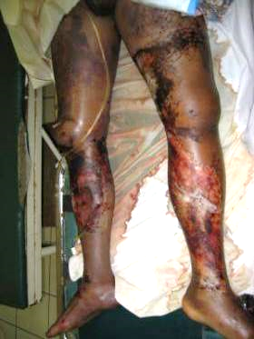
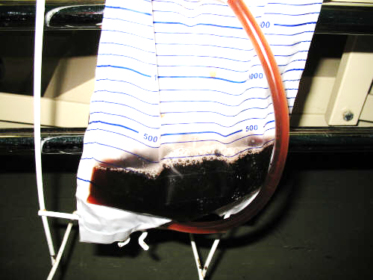
Life Threatening
Musculoskeletal Trauma
2) CRUSH SYNDROME
Mechanism
- Crush injury & long compression
Examination
- Dark Urine
- Rhabdomyolisis
Management
- Fluid resuscitation & osmotic diuretic

Slide 16
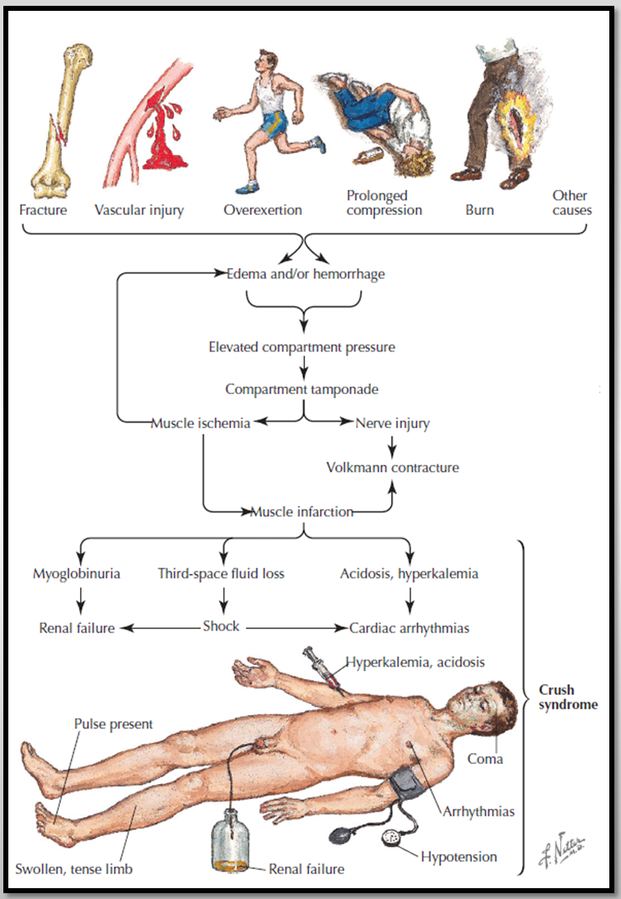
Pathophysiology
Crush Syndrome

Slide 17
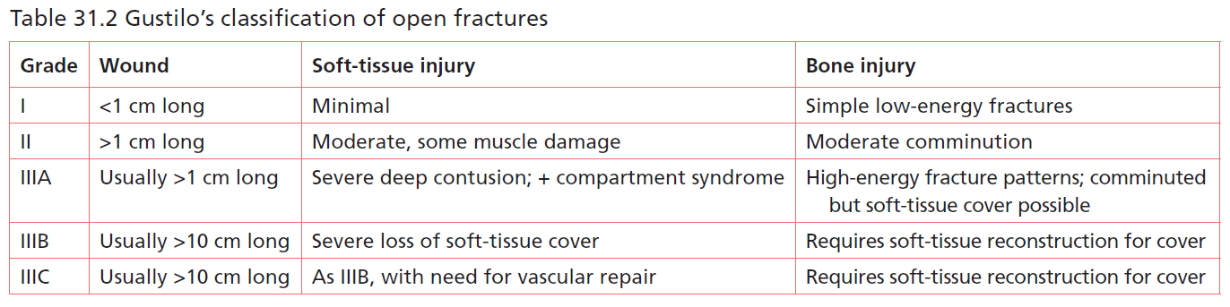
Limb Threatening
Musculoskeletal Trauma
1) OPEN FRACTURES
Risk of Infection (Sorger, 1999)
Grade I = 0-2%
Grade II = 2-7%
Grade III A = 10-25% ; Grade III B = 10-50% ; Grade III C = 25-50%

Slide 18
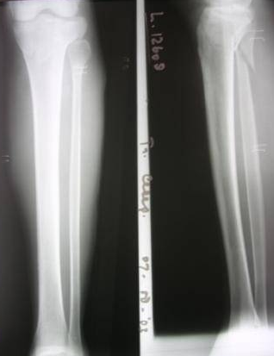
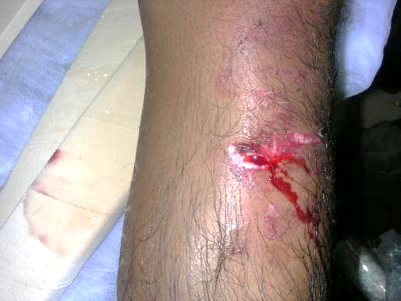
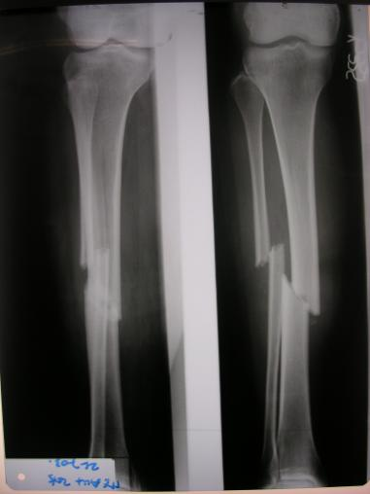
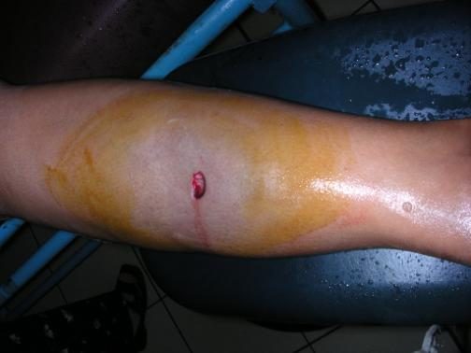
Open Fracture Grade I
Open Fracture Grade II

Slide 19
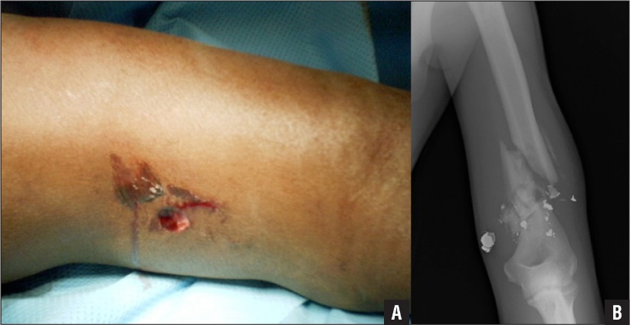
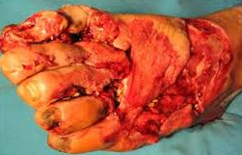
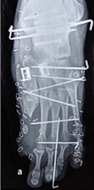
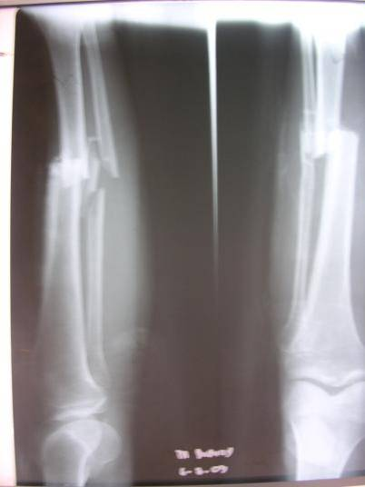
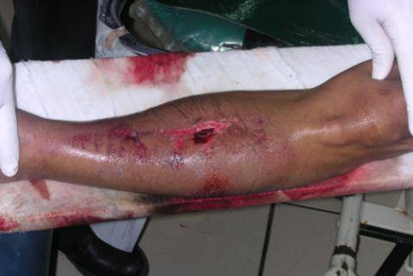
Open Fracture Grade III
Gunshot Injuries
Muzzle velocity > 600 m/s or >2000 ft/s
Military (assault) and hunting rifles
Wounds comparable –Gustilo type III regardless of size
Farmyard Injuries
  - Automatically at least Gustillo type III A
Open Fracture Grade III A

Slide 20
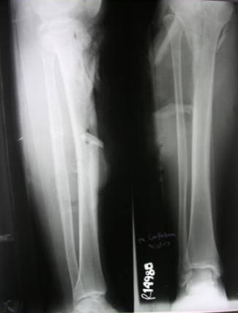
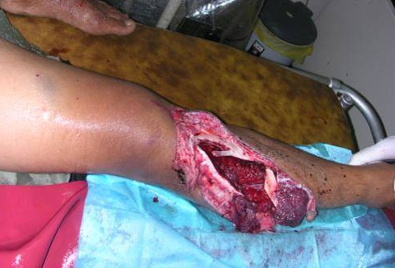
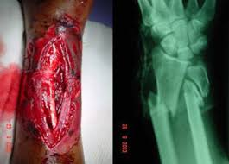
Open Fracture Grade III B
Open Fracture Grade III C

Slide 21
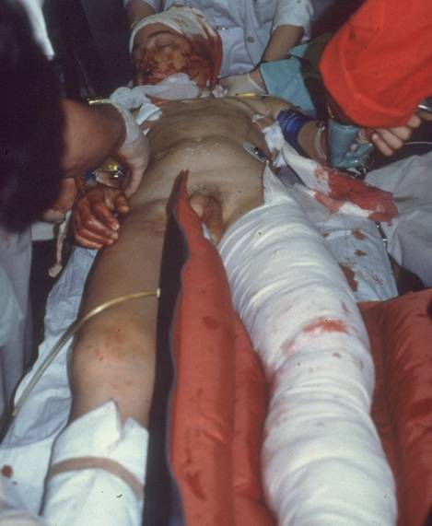
Open fractures in
Emergency Room...
Clinical examination
Vascular status
Neurolgic status
X-ray diagnostics
Resuscitation First!
4 Essential Treatments:
Antibiotic prophylaxis
Surgent wound and fracture debridement
Early definitive wound care
Stabilization of fracture

Slide 22
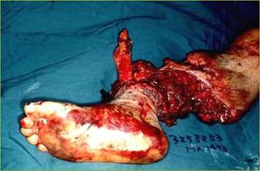
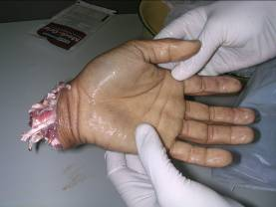
Limb Threatening
Musculoskeletal Trauma
2) Vascular Trauma & Traumatic Amputation
History & Examination ?
Time & Initial Management ?
Crush Or Sharp Wound ?

Slide 23
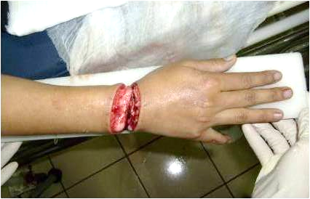
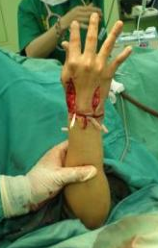
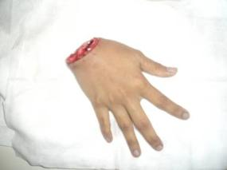
2) Vascular Trauma & Traumatic Amputation
Reduce fracture(s)
Splint fracture(s)
Assess by Doppler
Obtain consult (time is critical)
Consider angiography
Replantation?
Proper amputee management!
Immediate Orthopaedic consult

Slide 24
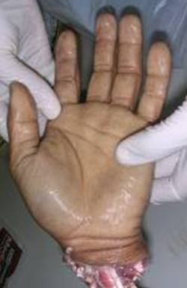
Proper Amputee Management
PLASTIC BAG
ICE IN NORMAL SALINE
PLASTIC BAG

Slide 25
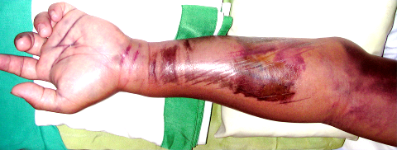

Limb Threatening
Musculoskeletal Trauma
3) Compartment Syndromes
Check for:
  Pain out of proportion in passive stretching
  Swelling, Shinny skin and tense compartment
  Pallor
Be careful in unconscious patient
5 P
Pain
Pallor
Paraestesia
Pulseless
Paralysis
Treatment
➔ Decompression by
Open fasciotomy

Slide 26


4) Joint Dislocations
Displacement of bone from normal joint
Location : hip, shoulder, elbow, finger, patella, knee, ankle, acromioclavicular
Sign : → loss of normal shape & movement
a) Elbow Dislocation

Slide 27



b) Shoulder Dislocation
Maneuver of Reduction:
Hippocratic
Milch
Stimson

Slide 28




c) Hip Dislocation
Posterior Dislocation “FAdIr”
Anterior Dislocation “FAbEr”

Slide 29



c) Hip Dislocation
Maneuver of Reduction:
Stimson’s gravity method
Bigelow
Allis
Always Check For
Neurovascular Injury !

Slide 30
SUMMARY
Primary Survey :
  Identify life-threatening injuries
Secondary Survey :
  Identify limb-threatening injuries
Proper immobilization
Early Orthopaedic consultation

